Slide 1

Selections
Program can decide which statements to execute based on a condition.
Example:
For ComputeArea.java program if radius is negative it should display an invalid result.
Java provides selection statements: statements that let you choose actions with alternative courses.

Slide 2
Selections
ComputeArea.java can be modified as:
if (radius < 0) {
System.out.println("Incorrect input");
}
else {
area = radius * radius * 3.14159;
System.out.println("Area is " + area);
}

Slide 3
Selections
Selection statements use conditions that are Boolean expressions.
A Boolean expression is an expression that evaluates to a Boolean value: true or false.

Slide 4
boolean Data Type
The boolean data type declares a variable with the value either true or false.
Java provides six relational operators (also known as comparison operators).

Slide 5
boolean Data Type
The result of the comparison is a Boolean value: true or false.
Example:
double radius = 1;
System.out.println(radius > 0); will display true.

Slide 6
boolean Data Type
A variable that holds a Boolean value is known as a Boolean variable.
The boolean data type is used to declare Boolean variables.
A boolean variable can hold one of the two values: true or false.
Example:
lightsOn:
boolean lightsOn = true;
true and false are literals, just like a number such as 10.
They are treated as reserved words and cannot be used as identifiers in the program.

Slide 7
if Statements
An if statement is a construct that enables a program to specify alternative paths of execution.
Java has several types of selection statements:
one-way if statements
two-way if-else statements
nested if statements
multi-way if-else statements
switch statements
conditional expressions

Slide 8
One-way if Statement
A one-way if statement executes an action if and only if the condition is true.
Syntax:
if (boolean-expression) {
statement(s);
}

Slide 9
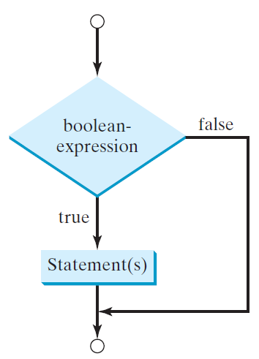
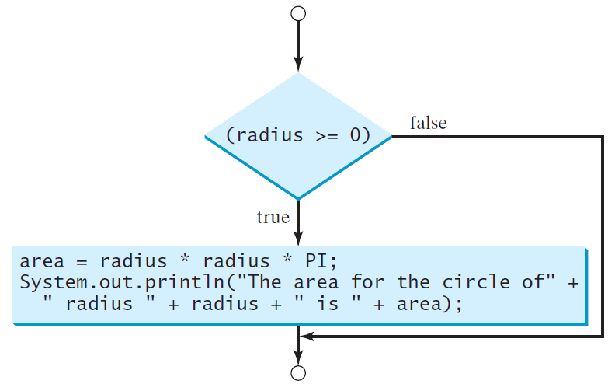
One-way if Statement
Flowchart:
Example:

Slide 10
One-way if Statement
Points to take care:

Slide 11
Two-way if-else Statement
An if-else statement decides the execution path based on whether the condition is true or false.
Syntax:
if (boolean-expression) {
statement(s)-for-the-true-case;
}
else {
statement(s)-for-the-false-case;
}

Slide 12
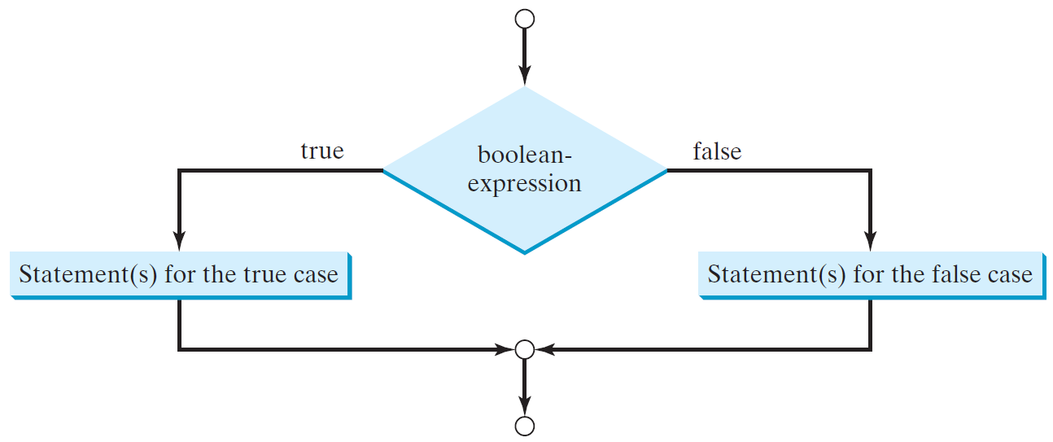
Two-way if-else Statement
Flowchart:

Slide 13
Two-way if-else Statement
Example:
if (radius >= 0) {
area = radius * radius * 3.14159;
System.out.println("The area for the “ + “circle of radius " + radius + " is " + area);
}
else {
System.out.println("Negative input");
}

Slide 14
Two-way if-else Statement
Do it yourself:
Write an if statement that increases pay by 3% if score is greater than 90, otherwise increases pay by 1%.

Slide 15
Nested if & Multi-way if-else Statements
The statement in an if or if-else statement can be any legal Java statement, including another if or if-else statement.
The inner if statement is said to be nested inside the outer if statement.
The inner if statement can contain another if statement.
There is no limit to the depth of the nesting.

Slide 16
Nested if & Multi-way if-else Statements
Example:
if (i > k) {
if (j > k)
System.out.println("i and j are greater than k");
}
else
System.out.println("i is less than or equal to k");

Slide 17
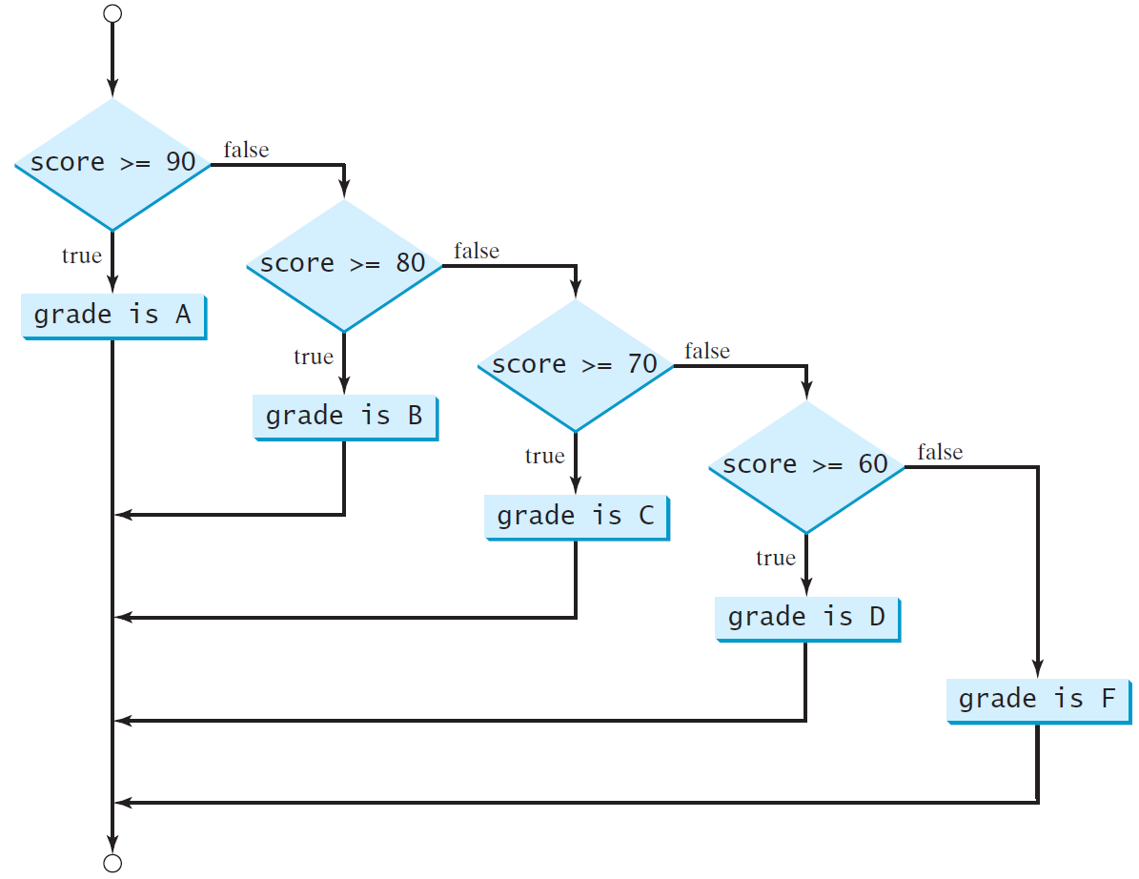
Nested if & Multi-way if-else Statements
Example:

Slide 18
Nested if & Multi-way if-else Statements
Example:

Slide 19
Nested if & Multi-way if-else Statements
State the output:
if (x > 2)
if (y > 2) {
int z = x + y;
System.out.println("z is " + z);
}
else
System.out.println("x is " + x);
x = 2, y = 3

Slide 20
Nested if & Multi-way if-else Statements
State the output:
if (x > 2)
if (y > 2) {
int z = x + y;
System.out.println("z is " + z);
}
else
System.out.println("x is " + x);
x = 3, y = 2

Slide 21
Nested if & Multi-way if-else Statements
State the output:
if (x > 2)
if (y > 2) {
int z = x + y;
System.out.println("z is " + z);
}
else
System.out.println("x is " + x);
x = 3, y = 3

Slide 22

Common Errors and Pitfalls
Forgetting Necessary Braces:
Adding a semicolon at the end of an if clause is a common mistake.
Multiple statements in if statement without braces in not allowed.

Slide 23
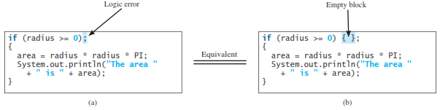
Common Errors and Pitfalls
Wrong semicolon at the end of if statement:
Adding a semicolon at the end of an if clause is a common mistake.
This mistake is hard to find, because it is not a compilation error or a runtime error, it is a logic error.
This error often occurs when you use the next-line block style.

Slide 24
Common Errors and Pitfalls
Redundant Testing of Boolean Variables:
Using the = operator instead of the == operator to compare the equality of two items in a test condition is a common error.
It could lead to the following erroneous statement:
if (even = true)
System.out.println("It is even.");
This statement does not have compile errors. It assigns true to even, so that even is always true.

Slide 25
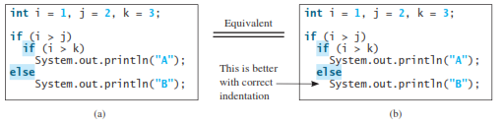
Common Errors and Pitfalls
Dangling else Ambiguity:

Slide 26
Common Errors and Pitfalls
Equality Test of two Floating-point values:
Consider the following code
double x = 1.0 – 0.1 – 0.1 – 0.1 – 0.1 – 0.1;
System.out.println(x == 0.5);
We cannot reliably test equality of two floating-point values.

Slide 27

Common Errors and Pitfalls
Simplifying Boolean Variable Assignment:

Slide 28
Common Errors and Pitfalls
Avoiding Duplicate Code in Different Cases:
if (inState) {
tuition = 5000;
System.out.println("The tuition is " + tuition);
}
else {
tuition = 15000;
System.out.println("The tuition is " + tuition);
}
This is not an error, but it should be better written as follows:
if (inState) {
tuition = 5000;
}
else {
tuition = 15000;
}
System.out.println("The tuition is " + tuition);

Slide 29
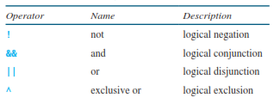
Logical Operators
The logical operators !, &&, ||, and ^ can be used to create a compound Boolean expression.

Slide 30
Logical Operators
p | !p | Example (assume age = 24, weight = 140)
true | false | !(age > 18) is false, because (age > 18) is true.
false | true | !(weight == 150) is true, because (weight == 150) is false.

Slide 31
Logical Operators
p₁ | p₂ | p₁ && p₂ | Example (assume age = 24, weight = 140)
false | false | false | (age <= 18) && (weight < 140) is false, because (age <= 18) and (weight < 140) are both false.
false | true | false | (age <= 18) && (weight >= 140) is false, because (age <= 18) is false.
true | false | false | (age > 18) && (weight > 140) is false, because (weight > 140) is false.
true | true | true | (age > 18) && (weight >= 140) is true, because both (age > 18) and (weight >= 140) are true.

Slide 32
Logical Operators
p₁ | p₂ | p₁ || p₂ | Example (assume age = 24, weihgt = 140)
false | false | false | (age < 14) || (weight <= 150) is false, because (age < 14) and (weight <= 150) both are false.
false | true | true | (age > 34) || (weight <= 140) is true, because (weight <= 140) is true.
true | false | true | (age > 14) || (weight >= 150) is true, because (age > 14) is true.
true | true | true | (age > 14) || (weight <= 150) is true, because (age > 14) and (weight <= 150) both are true.

Slide 33
Logical Operators
p₁ | p₂ | p₁ ^ p₂ | Example (assume age = 24, weight = 140)
false | false | false | (age > 34) ^ (weight > 140) is false, because (age > 34) is false and (weight > 140) is false.
false | true | true | (age > 34) ^ (weight >= 140) is true, because (age > 34) is false but (weight >= 140) is true.
true | false | true | (age > 14) ^ (weight > 140) is true, because (age > 14) is true and (weight > 140) is false.
true | true | false | (age < 34) ^ (weight <= 140) is false, because (age < 34) and (weight <= 140) both are true.

Slide 34
switch Statements
A switch statement executes statements based on the value of a variable or an expression.
Syntax:
switch (switch-expression) {
case value1: statement(s)1;
break;
case value2: statement(s)2;
break;
case value3: statement(s)3;
break;
.
.
case valueN: statement(s)N;
break;
default: statement(s)-for-default;
}

Slide 35
switch Statements
The switch statement observes the following rules:
he switch-expression must yield a value of char, byte, short, int, or String type and must always be enclosed in parentheses.
The value1, . . ., and valueN must have the same data type as the value of the switch-expression.
When the value in a case statement matches the value of the switch-expression, the statements starting from this case are executed until either a break statement or the end of the switch statement is reached.
The default case, which is optional, can be used to perform actions when none of the specified cases matches the switch-expression.
The keyword break is optional. The break statement immediately ends the switch statement.

Slide 36
switch Statements
A switch statement executes statements based on the value of a variable or an expression.
Example:
switch (status) {
case 0: compute tax for single filers;
break;
case 1: compute tax for married jointly or qualifying widow(er);
break;
case 2: compute tax for married filing separately;
break;
case 3: compute tax for head of household;
break;
default: System.out.println("Error: invalid status");
System.exit(1);
}

Slide 37
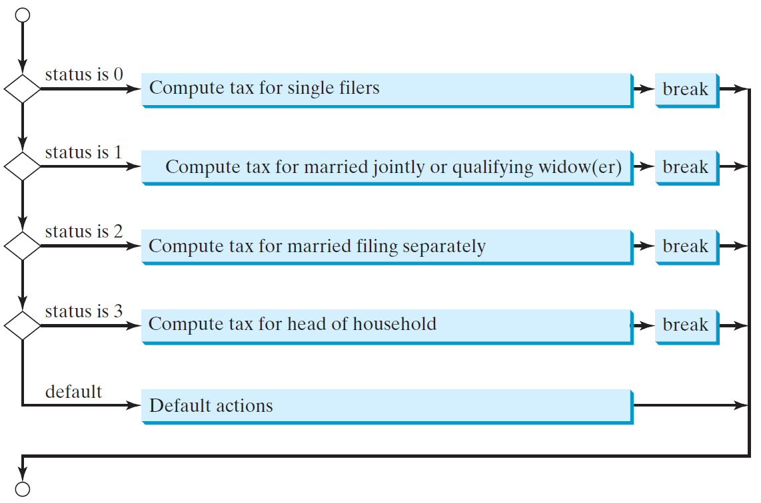
switch Statements

Slide 38
switch Statements
State the output of the following code (day has value between 0 to 6):
switch (day) {
case 1:
case 2:
case 3:
case 4:
case 5: System.out.println("Weekday"); break;
case 0:
case 6: System.out.println("Weekend");
}

Slide 39
Conditional Expressions
A conditional expression evaluates an expression based on a condition.
if (x > 0)
y = 1;
else
y = -1;
We can use a conditional expression to achieve the same result.
y = (x > 0)?1 : -1;
Conditional expressions are in a completely different style, with no explicit if in the statement.
Syntax:
boolean-expression ? expression1 : expression2;
The result of this conditional expression is expression1 if boolean-expression is true; otherwise, the result is expression2.

Slide 40
Conditional Expressions
Examples:
Assign the larger number of variable num1 and num2 to max.
max = (num1 > num2) ? num1 : num2;
Display the message “num is even” if num is even, and otherwise displays “num is odd.”
System.out.println((num % 2 == 0) ? "num is even" : "num is odd");

Slide 41
Operator Precedence & Associativity
Operator precedence and associativity determine the order in which operators are evaluated.
Expression:
3 + 4 * 4 > 5 * (4 + 3) – 1 && (4 - 3 > 5)
What is its value? What is the execution order of the operators?

Slide 42
Operator Precedence & Associativity
The expression in the parentheses is evaluated first.
Parentheses can be nested, in which case the expression in the inner parentheses is executed first.
When evaluating an expression without parentheses, the operators are applied according to the precedence rule and the associativity rule.
If operators with the same precedence are next to each other, their associativity determines the order of evaluation.
All binary operators except assignment operators are left-associative.

Slide 43
Operator Precedence & Associativity
a – b + c – d is equivalent to ((a – b) + c) – d
Assignment operators are right-associative.
Therefore, the expression
a = b += c = 5 is equivalent to a = (b += (c = 5))

Slide 44
Operator Precedence
var++, var--
+, - (Unary plus and minus), ++var,--var
(type) Casting
! (Not)
*, /, % (Multiplication, division, and remainder)
+, - (Binary addition and subtraction)
<, <=, >, >= (Relational operators)
==, !=; (Equality)
^ (Exclusive OR)
&& (Conditional AND) Short-circuit AND
|| (Conditional OR) Short-circuit OR
=, +=, -=, *=, /=, %= (Assignment operator)

Slide 45
Operator Precedence & Associativity

Slide 46
Any Questions?

